Slide 1
Gauss-Jordan Elimination
Ben Rorabaugh
(ft. Gauss and Jordan)

Slide 2
Purpose
Invert a matrix
Find the specific solution to a system of equations

Slide 3
Elementary Row Operations
Swap two rows
Multiply an entire row by a (non-zero) scalar
Add a multiple of a row to another row

Slide 4
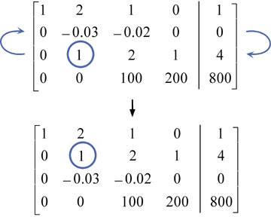
Pivoting
Pivoting refers to choosing one row with a more easily workable number and swapping it so that the workable number is on the diagonal.

Slide 5
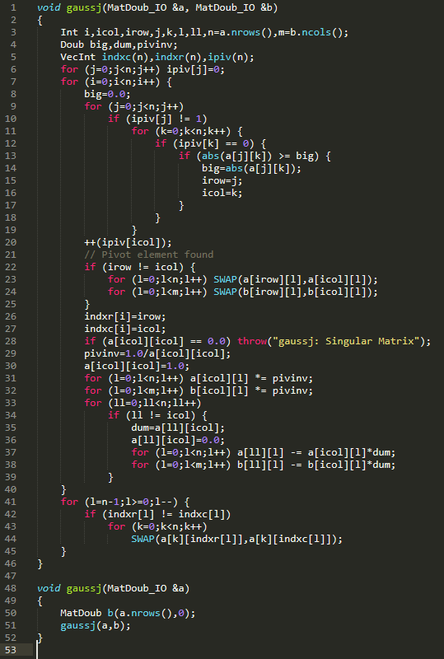
Gauss-Jordan Elimination in the C++ Library

Slide 6
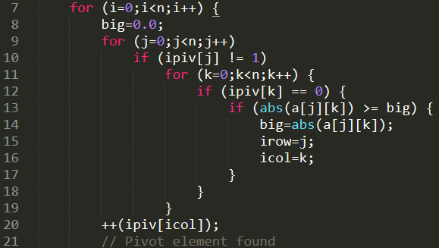
Pivoting in the C++ Library
The gaussj() function finds a pivot by finding the greatest element in the desired row.

Slide 7
Pivoting in the C++ Library (continued)
The function then swaps the chosen pivot row so that the pivot element is on the diagonal.

Slide 8
Computing the Solution
The function then divides all other rows by the pivot element.

Slide 9
Computing the Solution (continued)
The function then subtracts the pivot row from all other rows.
This entire process is repeated for all rows in the input matrix.

Slide 10
Example
Input:
2w + 3x + 1y - 2z = -4
0w - 2x + 3y - 5z = 3
2w + 5x - 1y - 1z = -5
3w + 2x + 0y + 4z = 6
Expected Solution:
w = -2
x = 0
y = 6
z = 3
g++ main.cpp -o main
./main in3.txt

Slide 11
Changes I made to the textbook's code
The textbook's code will always calculate the inverse of matrix A, with the specific solution in column B, if applicable.
With the addition of a boolean parameter and some conditions using the parameter, we can have the program eliminate columns as expected

Slide 12
The elimination algorithm for an n x n matrix
Loop n times:
Find the largest (abs. value) element in the matrix (that hasn't already been pivoted with); this is the pivot element
If the pivot element is not on the diagonal, swap rows so that it is
Normalize the row of the pivot element
Loop through all non-pivot rows:
Subtract the pivot row times the coefficient of the row's element in the pivot column

